Slide 1
DNA Analysis in Criminal Cases:
Understanding the fundamentals of DNA Testing and Identifying Current Legal Issues.

Slide 2
What is DNA?
Deoxyribonucleic Acid (DNA)
Blueprint for human development
– one set of blueprints per human (Genome)
– 99% identical among all humans
– Remaining 1% makes you recognizable as an
individual, so polymorphic (or highly variable) regions of DNA are targeted for analysis.
Two kinds: 1. Nuclear, 2. Mitochondrial
Nuclear DNA is bundled into 46 chromosomes, which form 23 pairs.
- 23 from egg (mother), 23 from sperm (father)
– 1 pair of chromosomes determines sex
• XX female, XY male
– 22 pairs of chromosomes determine physical attributes, regulate development, etc.
Many Mitochondria (passed from mother to all of her children)

Slide 3
DNA Inheritance and Biological Relatedness
DNA shared by a person and his/her:
Parents: exactly 1/2
Full siblings: 1/2 on average
Half siblings: 1/4 on average
First cousins: 1/8 on average
Identical Twins: Genetically indistinguishable with current forensic methods

Slide 4
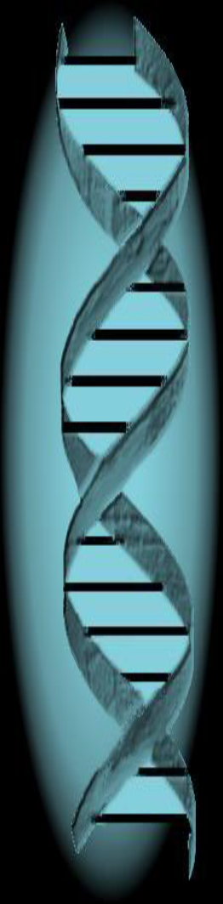
Sources of Biological Material
Blood •Bone
Semen •Epithelial (skin) cells
Saliva •Teeth
Urine •Sweat
Vomit •Tissue
Hair
Feces (difficult, many inhibitors, need specialized lab)

Slide 5
Potential DNA Evidence:
Sexual Assault Kits
Masks
Hats/ sweatbands
Gloves
Clothing
Bedding
Fingernail scrapings
Ligatures (rope, wire, cord)
Bottles/ cans
Earrings
Watches
Combs
Eyeglasses
Bite marks
Condoms
Toothbrushes
Chewed gum
Toothpicks
Used Tissues
Licked stamps/envelopes
Cigarette butts
Keys
Guns/ knifes/ bats
Bullets

Slide 6
Probative Items of Evidence from Crime Scenes
The best DNA evidence arises when a person’s DNA is found where it is not supposed to be.
Items moved by the perpetrator
Items left behind by the perpetrator
Points of entry or exit
Recovered stolen items
Police questioning may focus on this principle.
i.e.: Do you know the victim? Have you ever been here? Initial photographs.

Slide 7
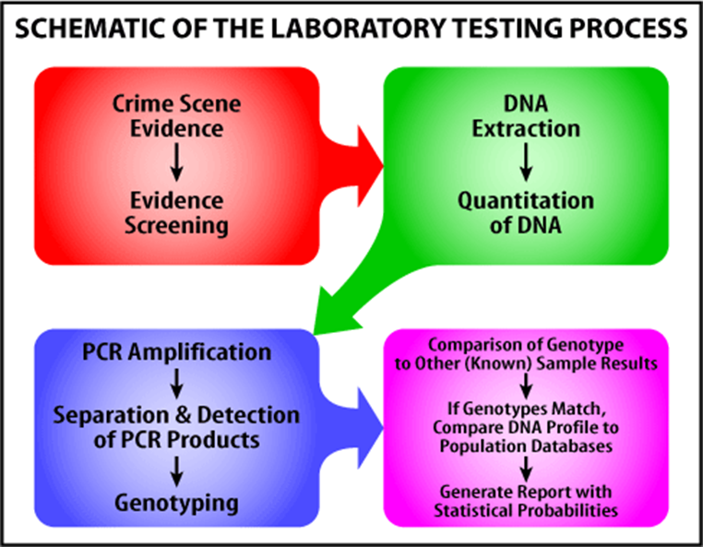
DNA Testing Process
Evidence Screening (serology testing)
Extraction
Quantitation
Amplification
Separation
Analysis and Interpretation
See People v Evans, Michigan Court of Appeals No.304434, Nov. 15, 2012, unpublished.

Slide 8
DNA Testing Process: 1. Serology/Evidence Screening
Presumptive testing:
Sensitive.
Somewhat specific to body fluids, but cannot unequivocally determine if a particular body fluid is on an item (false positives).
Only indicate a body fluid might be present.
Fast.
Confirmatory Testing:
Specific to particular body fluids and/or sometimes to a particular species.
DNA testing considered confirmatory.

Slide 9
DNA Testing Process: 1. Serology/Evidence Screening (cont.)
Identifying Semen: seminal fluid and spermatozoa (sperm)
Presumptive:
Ultraviolet (UV) Light or Alternate Light Source
Acid phosphatase (AP) screening:
screen for seminal fluid using Brentamine spot test.
Confirmatory:
Microscopic Identification of Sperm:
stains commonly used for visualization of sperm are nuclear fast red (red stain) and picroindigocarmine (green stain)
Protein Confirmation of Semen:
test for a protein specific to semen known as prostate-specific antigen (aka PSA or p30)
DNA Testing

Slide 10
DNA Testing Process: 1. Serology/Evidence Screening (cont.)
Identifying Blood:
Presumptive:
Phenolphthalein (PH):
Very sensitive, false + for: rust, copper, metal salts, salt-treated lumber, potatoes, horseradish.
Luminal and fluorescein test:
for large surfaces, very sensitive, same false + as PH, plus bleach and other cleaners.
Tetramethylbenzidine (TMB):
less sensitive, more specific than PH
Leuvomalachite green (LMG)
Species Testing of Blood
Confirmatory:
ABO Blood typing
DNA testing

Slide 11
DNA Testing Process: 1. Serology/Evidence Screening (cont.)
Identifying Saliva:
Presumptive:
Fluoresce/ Alternate light
Amylase Screening- enzyme found at high level in saliva, but also found in other body fluids, plants, and some bacteria. Doesn’t confirm the presence of salivary amylase.
Confirmatory:
DNA testing

Slide 12
DNA Testing Process: 2. Extraction
Extraction: the process of purifying DNA cells from an item (substrate), releasing and separating the DNA from the cells and inhibitors.
Differential DNA Extraction:
A type of extraction from intimate samples, which takes the mixed sample and attempts to separate DNA derived from spermatozoa from all other sources of DNA, resulting in a sperm fraction (SF) and a non-sperm or epithelial cell fraction (EF).
Differential extraction is NOT exact.
Must be processed concurrently with an extraction negative control (aka reagent blank) to monitor for contamination.
Reagent blanks should never give a DNA result, unless it is contaminated.

Slide 13
DNA Testing Process: 3. Quantitation
Measuring how much DNA is present.
Is there enough to test?
Which testing method is best for the amount of DNA present?
Issues result with using too much or too little DNA (ie allelic drop out, stutter, etc.)

Slide 14
DNA Testing Process: 4. Amplification
(Polymerase Chain Reaction or PRC) Copying the specific regions on the DNA strand, yielding more DNA for examination, with tags.

Slide 15
DNA Testing Process: 5. Separation
The extracted and now amplified DNA must be separated so that alleles can be differentiated from each other.

Slide 16
DNA Testing Process: 6. Analysis and Interpretation
Forensic DNA analysts must convert fluorescence data (peaks on an electropherogram) into information that can be shared and communicated with lay persons.
When interpreting the data, analysist have much more discretion, and thus potential bias, than often realized.

Slide 17
DNA Testing Process: 6. Analysis and Interpretation
Electopherogram
Single Source
DNA Profile.
Peaks= Alleles
Consider the
Height and
Number of
peaks present.
1= homozygous
2=

Slide 18
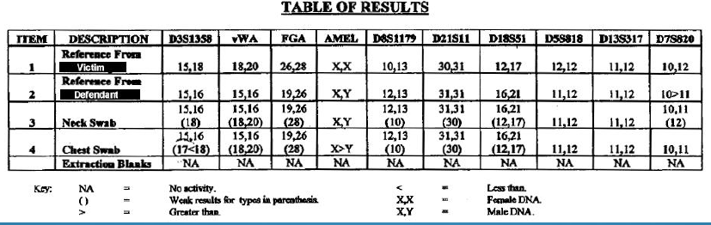
DNA Testing Process: 6. Analysis and Interpretation
Peaks interpreted to yield results.
Summarizes the labs findings with regard to each sample (reference, elimination, evidence).
Single source v Mixtures

Slide 19
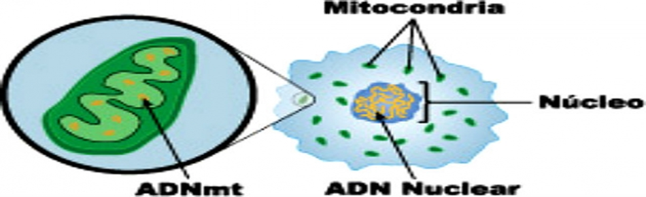
Types of DNA Testing
Nuclear v. Mitochondrial
Nuclear
STR analysis(autosomal)
Y-STR analysis (haplotype)
Image: http://www.sandiegored.com/

Slide 20
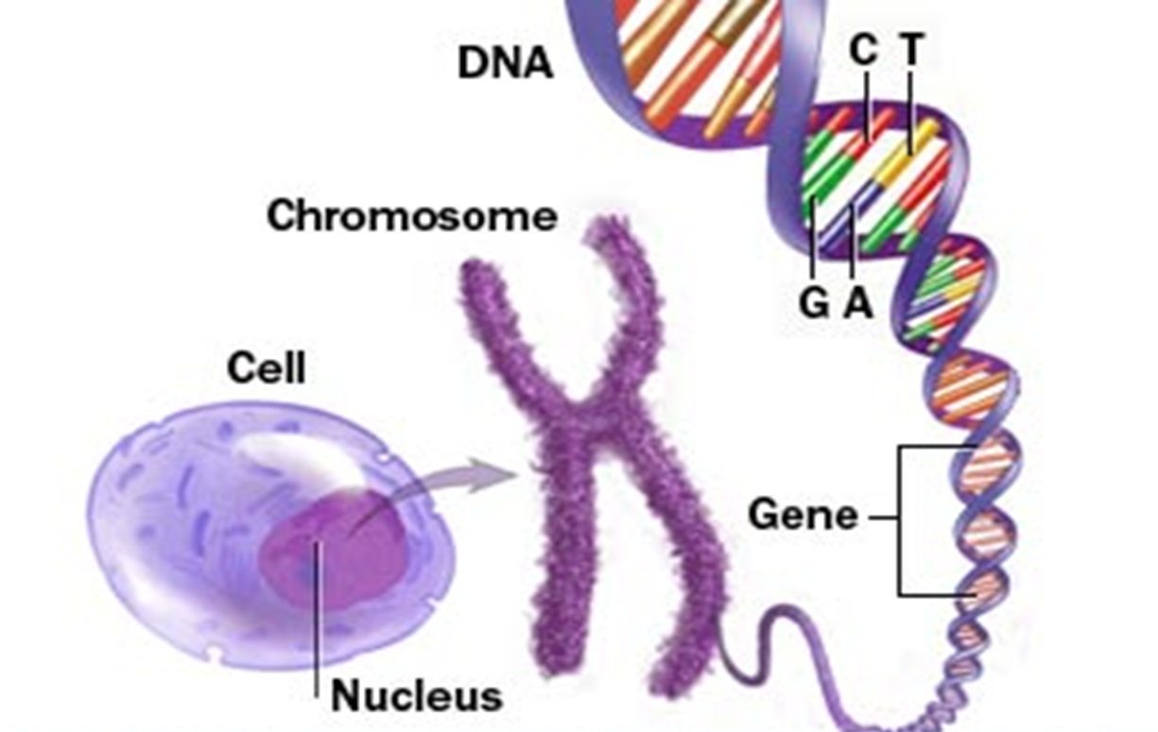
Nuclear DNA Basics
Mitochondria

Slide 21
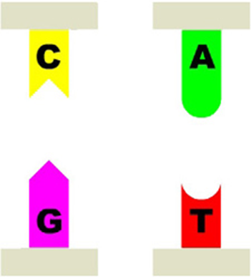
Nuclear DNA Basics
DNA is comprised of only four building blocks (bases): Guanine, Cytosine, Thymine, Adenine.
• Each base must pair with one other base, creating a helix.
A=T, G=C
The DNA Initiative: www.dna.gov.

Slide 22
DNA Basics
Locus/Loci: (aka “marker”) Specific location(s) of DNA.
–May or may not represent a gene (non-coding DNA)
Gene: A particular site or location on the DNA, generally thought to encode a visible trait or functional protein
–Genes for hair color or eye color
–Like a chapter in a book
STR testing DNA locations are specifically selected to be:
privacy protecting, by using non-coding or “junk” regions that reveal nothing about one’s genetic traits,
“Polymorphic”- highly variable between individuals, and
Easy to work with in the lab- easily amplified and interpreted by the electrophoresis instrumentation

Slide 23
DNA Basics
Allele: One of the possible forms of a given gene
Red hair allele, blonde hair allele, brown hair allele
Polymorphism: The existence of a gene in several forms. The more polymorphic the gene, the more variations of the trait it encodes.
Also includes length polymorphism
Many areas of DNA contain repeating units
GGGA-GGGA-GGGA-GGGA
Some are long, some are short (3-4 repeats or +40 repeats)
All are inherited from your parents
The polymorphisms tested in forensics are length polymorphisms.
Reported as a number
The number indicates the length of the DNA repeat sequence.

Slide 24



Nuclear DNA Basics
Gene for eye color
Gene for hair color
Non-coding locus

Slide 25
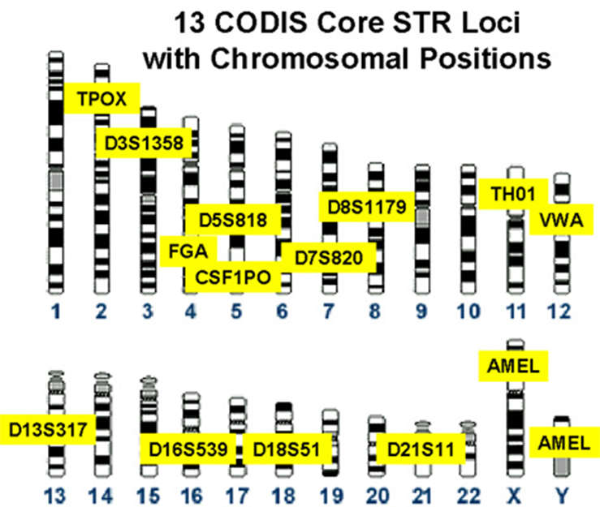
Nuclear DNA Testing
DNA testing kits test at 13-16 regions (aka “markers” or “loci”)

Slide 26
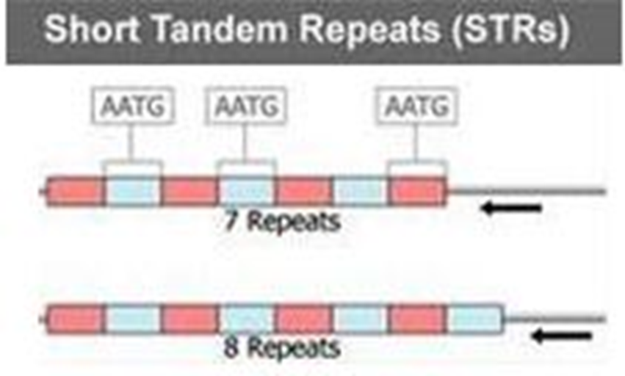
STR – Short Tandem Repeat
STRs demonstrate Length Polymorphism or Length alleles
To determine the “alleles” at a particular locus, just count the number of repeats.
Repeat sequence = AATG
Result reported is 7, 8.
Image : http://www.hawgoodfamily.co.uk

Slide 27
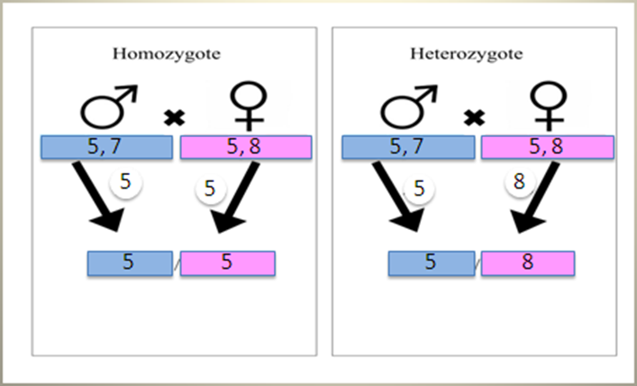
STR
Each locus has two alleles (one from each parent) – may be the same (homozygotic) or different (heterozygotic)

Slide 28
STR (Short Tandem Repeat):
late 1990s-present
Advantages:
Much more sensitive than older methods
Number of markers makes it highly discriminating. Unique profile, except identical twins.
Compatible with State and Federal (CODIS) databases
Allows for sex typing
Differential extraction was also developed around the same time.
Disadvantages:
Masking (high female/male DNA ratio
Mixtures

Slide 29
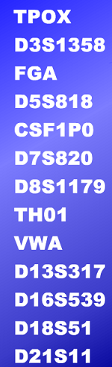
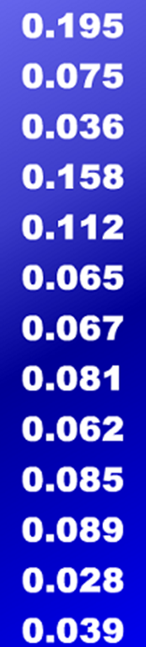
Nuclear DNA Testing - Statistics
The probability of a random match is calculated by applying the product rule to the probability of the allele found at each locus.
Table: promega.com, Allele Frequencies
0.195 x 0.075 = 0.0146 = 1 in 68 people (1/.0146)
0.195 x 0.075 x 0.036 = 0.0005 = 1 in 2000 people (1/.0005)
Etc.
Multiply them ALL together and you get 1 in 594 trillion!
Modified from DNA.gov.

Slide 30
Nuclear DNA Testing - Statistics
Caveats
In order to call a DNA inclusion, must have a stat.
See People v Coy, 243 Mich App 283; 620 NW2d 888 (2000), holding a DNA analysis was not admissible without accompanying statistical evidence.
Can’t use product rule for Y-STR or Mito
Labs use the Counting Method and Apply a 95% confidence interval to determine inclusion stat
Can’t use random match probability for complex mixtures
Other ways to calculate stats:
CPI
Likelihood Ratios

Slide 31
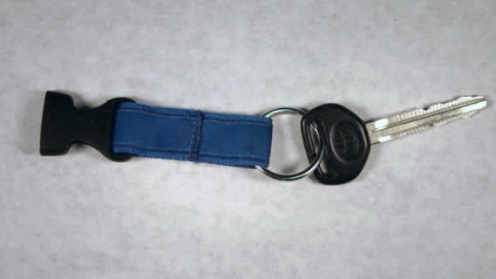
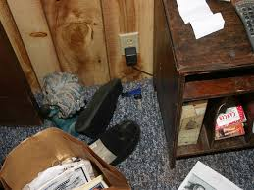
Other Current DNA Testing Methods
“Touch DNA”
Evidence left behind that is not visible to the naked eye.
30-40,000 skin cells shed per hour, so ~500/minute
With more contact and/or textured surfaces, more skin cells are left behind
A minimum of ~20 skin cells are needed for a forensic profile
–Handling an object for ~5 seconds. But, the more handling, the better the profile.
May be the only DNA evidence at non-violent crimes
Very sensitive testing, requires care.
–Extremely low quantities of DNA are present.
•Likely will not give complete results (partial profile).
Frequently result in mixtures of the DNA from more than one individual.

Slide 32
Other Current DNA Testing Methods
MiniFiler STR: late 2000s – present
Advantages
Good for degraded samples
More sensitive so less DNA needed
Good as adjunct to STR
Where STR only gets partial profile, miniSTR may help to obtain a more complete profile
Disadvantages
Because it is more sensitive, can produce complex mixed profiles, including contaminants
Other Newer Kits That May Be Good for Degraded/Inhibited Samples
Powerplex Hot Start (HS) 16
Identifiler Plus
Globofiler

Slide 33
Other Current DNA Testing Methods
Y-STR (Y Chromosome DNA Testing): early 2000s-present
Variant of autosomal STR that tests for DNA in the Y chromosome
Advantages
Good for use in samples with little male DNA and lots of female DNA, OR delayed evidence collection, so no sperm present.
Good for use in samples with DNA from multiple males
Paternally inherited so you can use relatives’ DNA as elimination samples
Disadvantages
Paternally inherited so it’s not as discriminating as STR and NOT UNIQUE, as it passes UNCHANGED
Not compatible with CODIS
Can’t be used where paternal relative or female is alternative suspect
See People v Wood, 307 MichApp 485 (2014).

Slide 34
Other Current DNA Testing Methods
Mitochondrial DNA testing: late 1990s-present
Advantages
Good for testing hairs without roots
Maternally inherited so you can use relatives’ DNA as elimination samples
Disadvantages
Maternally inherited and passes UNCHANGED so less discriminating than STR (NOT UNIQUIE)
One’s mtDNA may be different in different parts of their body.
Population database less reliable.
Not compatible with CODIS or state databases
Mixtures are extremely difficult to interpret

Slide 35
Other Current DNA Testing Methods
Y-STR (Y Chromosome DNA Testing): early 2000s-present
Variant of autosomal STR that tests for DNA in the Y chromosome
Advantages
Good for use in samples with little male DNA and lots of female DNA
Good for use in samples with DNA from multiple males
Paternally inherited so you can use relatives’ DNA as elimination samples
Disadvantages
Paternally inherited so it’s not as discriminating as STR
Not compatible with CODIS
Can’t be used where paternal relative or female is alternative suspect

Slide 36
Possible Results Upon Profile Comparison:
“match” or “inclusion”
“consistent with” or “failure to exclude”
“nonmatch” or “exclusion”
“inconclusive” - If there are insufficient data to support a conclusion, the finding is often referred to as

Slide 37
Strategies For Using DNA To Exonerate
Three main ways that DNA can be used to exonerate:
Exclusion of defendant from probative item
Exclusion plus getting redundancy
Exclusion plus identifying contributor of DNA

Slide 38
Issues:
Mixtures
•Indicates DNA left behind from more than one person
•Can be interpretable or uninterpretable
•May be able to identify the predominant or “major” contributor
•Common with touch DNA samples
•Consider the source of your DNA
–Gender of source can help
• Expectation or “confirmation bias” can cause analysts to:

Slide 39
Examples of Discretionary Calls

Slide 40
Examples of Discretionary Calls

Slide 41
Examples of Discretionary Calls

Slide 42
Issues:
Masking
•Often overwhelming victim DNA can “Mask” suspect DNA
–Seen in rape cases where the victim’s DNA is in high quantity as compared to a low quantity of suspect DNA
–Swabbings of bitemarks

Slide 43
Issues:
Contamination or Secondary Transfer
• DNA can be carried off from the original location
• Three forms:
– Person-person-object
• Handshake to a weapon
– Person-object-person
• Suspect to knife to bystander
– Person-object-object
• Bystander-towel-gun

Slide 44
Michigan DNA Statute
But, post 2001 convictions, Defendant must also show:
DNA testing was done at trial,
Testing was “inconclusive”
Testing with current technology could give a conclusive result.

Slide 45
DNA Case Law
People v. Barrera, 278 Mich.App. 730, 737, 752 N.W.2d 485 (2008).
Issue: Evidence sought to be tested is material to the issue of the convicted person's identity as the perpetrator…of the crime.
The COA interpreted the language in § 16(4)(a), which at that time was found in § 16(3)(a), holding that biological evidence “must be of some consequence to the issue of identity” or, stated differently, that there must be “some logical relationship between the evidence sought to be tested and the issue of identity.”
The language in MCL 770.16(4)(a) “requires a defendant to link DNA evidence sought to be tested to both the crime and the criminal in order to show materiality....” Id. at 740, 752 N.W.2d 485.

Slide 46
DNA Case Law
People v Poole, 311 Mich App 296 app den 498 Mich 922; 871 NW2d 197 (2015)
DNA testing could be inconclusive, could point to defendant as being a donor, or could exclude defendant as the source of any blood samples, along with potentially identifying another specific individual as the donor, thereby clearly satisfying MCL 770.16(4)(a). Because DNA testing of a blood sample could possibly connect another person to the crime scene or exclude defendant, the sample would be of some consequence or have a logical relationship to the issue of identity and would be linked to both the crime and the criminal. In other words, the blood samples would necessarily be material to defendant's identity as the perpetrator.

Slide 47
Other Resources:
A Simplified Guide to a variety of Forensic science topics, including DNA: www.forensicsciencesimplified.org.
The DNA Initiative: www.dna.gov.
Principles of Forensic DNA for Officers of the Court: http://projects.nfstc.org/otc/

